Slide 1


Leveraging Machine Learning for Depression Screening A Step Towards Proactive Intervention
PGPDSE – Hyd, Mar’24
TeamONE
Dileep, Praneeth, Sreekar, Ghouse, Sreehitha, Kalyani
Mentored by - Ankush Bansal

Slide 2
Leveraging Machine Learning for Depression Screening A Step Towards Proactive Intervention
PGPDSE – Hyd, Mar’24
TeamONE
Dileep, Praneeth, Sreekar, Ghouse
Mentored by - Ankush Bansal

Slide 3
INDEX
Problem Statement
Background research
Dataset
Getting to know about data
All charts
EDA
Nulls
Encoding
Scaling
Model build
Metrics display Function
All Models
Hyperparameter Tunning
Optuna
Deployment
Pipeline
HTML & CSS
Flask
Render

Slide 4






SUMMARY
Team
One

Slide 5

ABOUT PROBLEM

Slide 6

PROBLEM
Team
One
“
The objective of this project is to develop and deploy a predictive classification model to identify individuals at risk of depression based on a variety of demographic, lifestyle, and medical factors.

Slide 7
BACKGROUND
Team
One
The Silent Epidemic:
Depression affects millions globally, impacting all aspects of life. While 3.8% of the population experience it, the true number is likely higher due to stigma and lack of access to care.
More Than Just Sadness
Depression isn't simply feeling down. it's a complex mental health disorder with debilitating symptoms like loss of interest, hopelessness, and suicidal thoughts. These can disrupt work, relationships, and overall well-being.
A Multifaceted Challenge
Depression arises from a combination of social, psychological, and biological factors. Stressful life events, physical health issues, and even genetics can play a role.

Slide 8

ABOUT
DATASET

Slide 9

DATASET
Team
One
Converting from *.csv to *.parquet
Parquet is an open-source columnar storage file format designed for efficient data processing. Unlike CSV, which stores data row-by-row, Parquet stores data column-by-column. This columnar organization offers several key advantages
Faster data loading
Reduced storage space
Improved data integrity
Enhanced performance for machine learning tasks
to_parquet.py
import pyarrow as pa
import pyarrow.parquet as pq
file = pd.read_csv("depression_data.csv")
table = pa.Table.from_pandas(file)
pq.write_table(table, "depression_data.parquet")
40%
*.parquet
file took
less time to load
that *.csv file

Slide 10
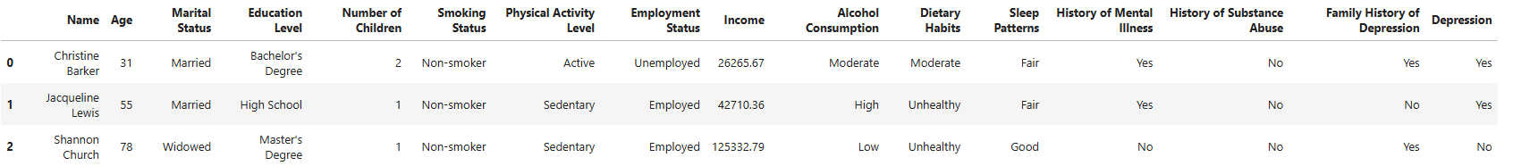
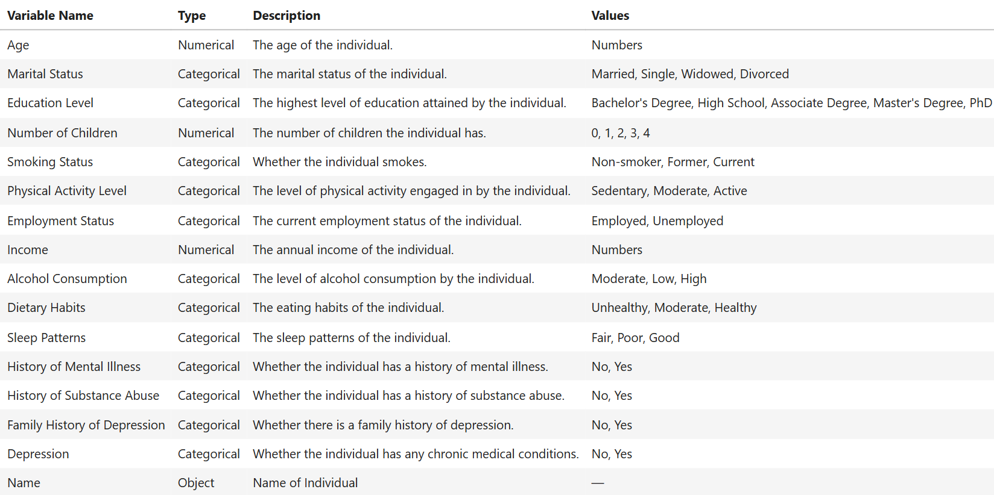
DATASET
Team
One
Shape
Rows : 4,13,768
Columns : 16
Dtypes Columns
Categorical : 13
Numerical : 2
Object : 1

Slide 11
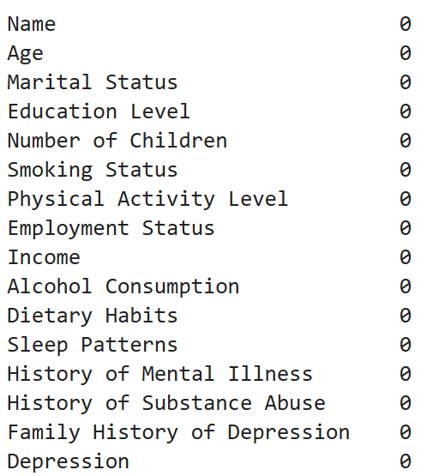
NULLS & DUPLICATES
Team
One
Why..?
Algorithm Compatibility
Biased Analysis
Reduced Statistical Power
There are no Null Values in this Dataset
There are no Duplicate Values in this Dataset

Slide 12

VISUAL INFERENCE

Slide 13
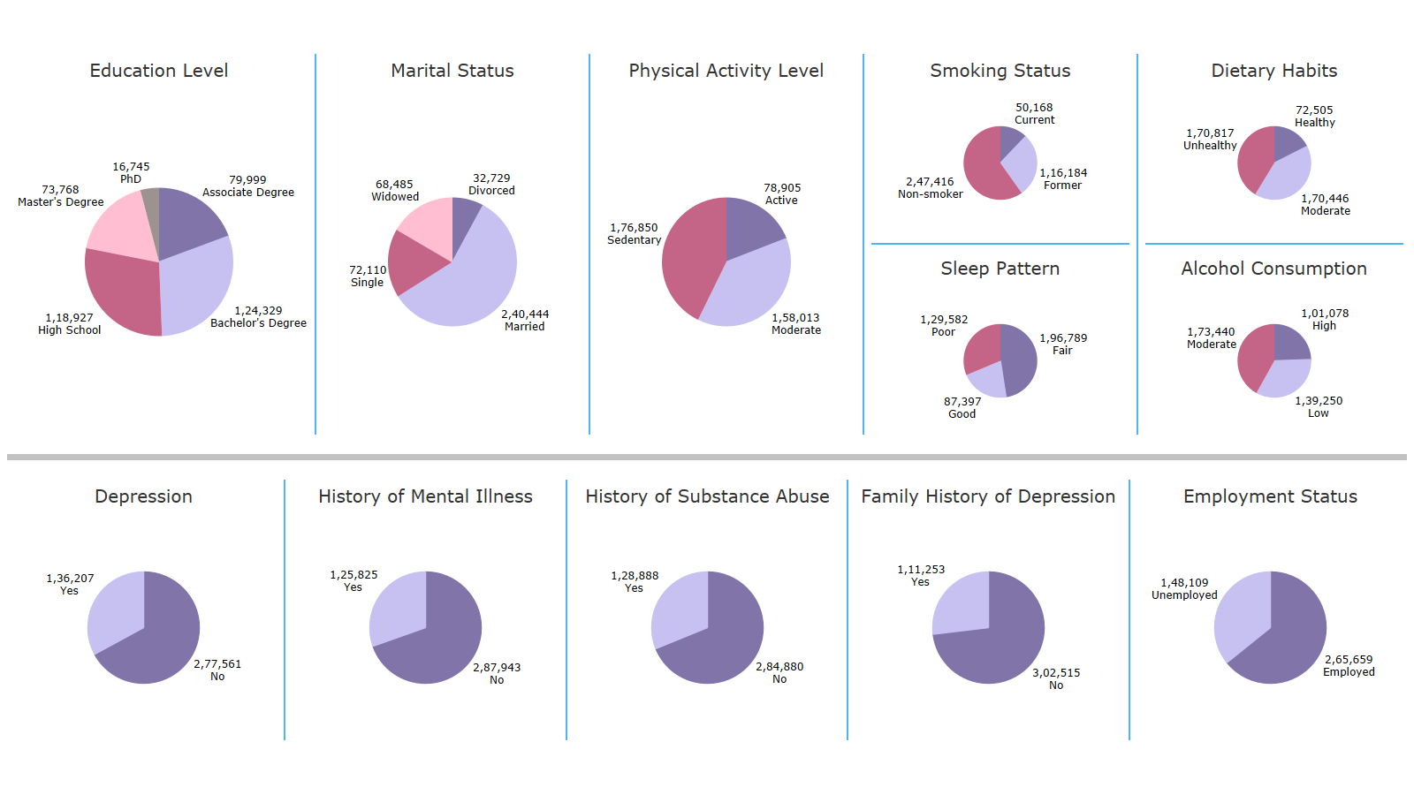

Slide 14
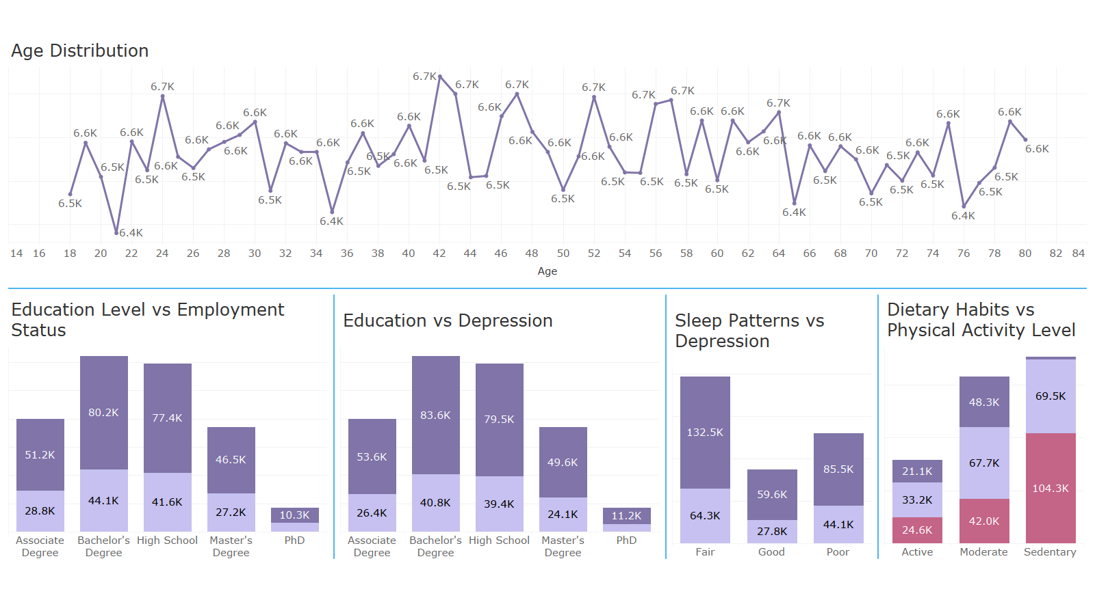

Slide 15
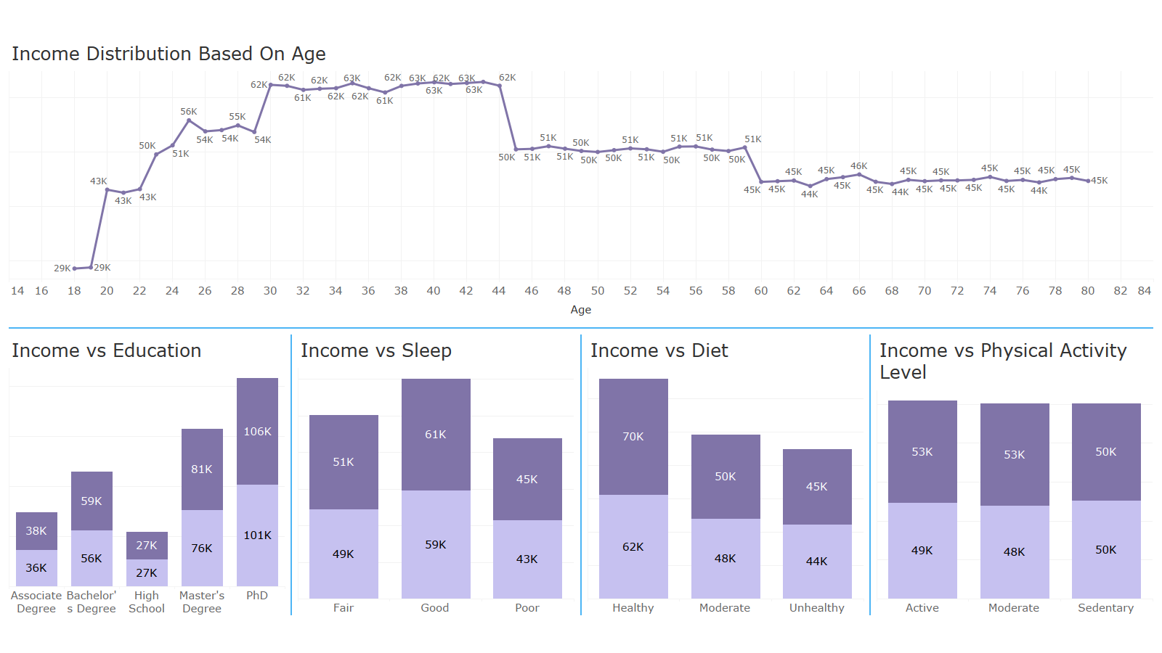

Slide 16
H0 H1 H0 H1 H0 H1 H0 H1 H0 H1 H0 H1 H0 H1 H0 H1 H0 H1 H0 H1 H0 H1 H0 H1 H0 H1 H0 H1 H0 H1 H0 H1
H0 H1 H0 H1 H0 H1 H0 H1 H0 H1 H0 H1 H0 H1 H0 H1 H0 H1 H0 H1 H0 H1 H0 H1 H0 H1 H0 H1 H0 H1 H0 H1
H0 H1 H0 H1 H0 H1 H0 H1 H0 H1 H0 H1 H0 H1 H0 H1 H0 H1 H0 H1 H0 H1 H0 H1 H0 H1 H0 H1 H0 H1 H0 H1
H0 H1 H0 H1 H0 H1 H0 H1 H0 H1 H0 H1 H0 H1 H0 H1 H0 H1 H0 H1 H0 H1 H0 H1 H0 H1 H0 H1 H0 H1 H0 H1
HYPOTHESIS
TESTING
H0 H1 H0 H1 H0 H1 H0 H1 H0 H1 H0 H1 H0 H1 H0 H1 H0 H1 H0 H1 H0 H1 H0 H1 H0 H1 H0 H1 H0 H1 H0 H1
H0 H1 H0 H1 H0 H1 H0 H1 H0 H1 H0 H1 H0 H1 H0 H1 H0 H1 H0 H1 H0 H1 H0 H1 H0 H1 H0 H1 H0 H1 H0 H1
H0 H1 H0 H1 H0 H1 H0 H1 H0 H1 H0 H1 H0 H1 H0 H1 H0 H1 H0 H1 H0 H1 H0 H1 H0 H1 H0 H1 H0 H1 H0 H1
H0 H1 H0 H1 H0 H1 H0 H1 H0 H1 H0 H1 H0 H1 H0 H1 H0 H1 H0 H1 H0 H1 H0 H1 H0 H1 H0 H1 H0 H1 H0 H1

Slide 17
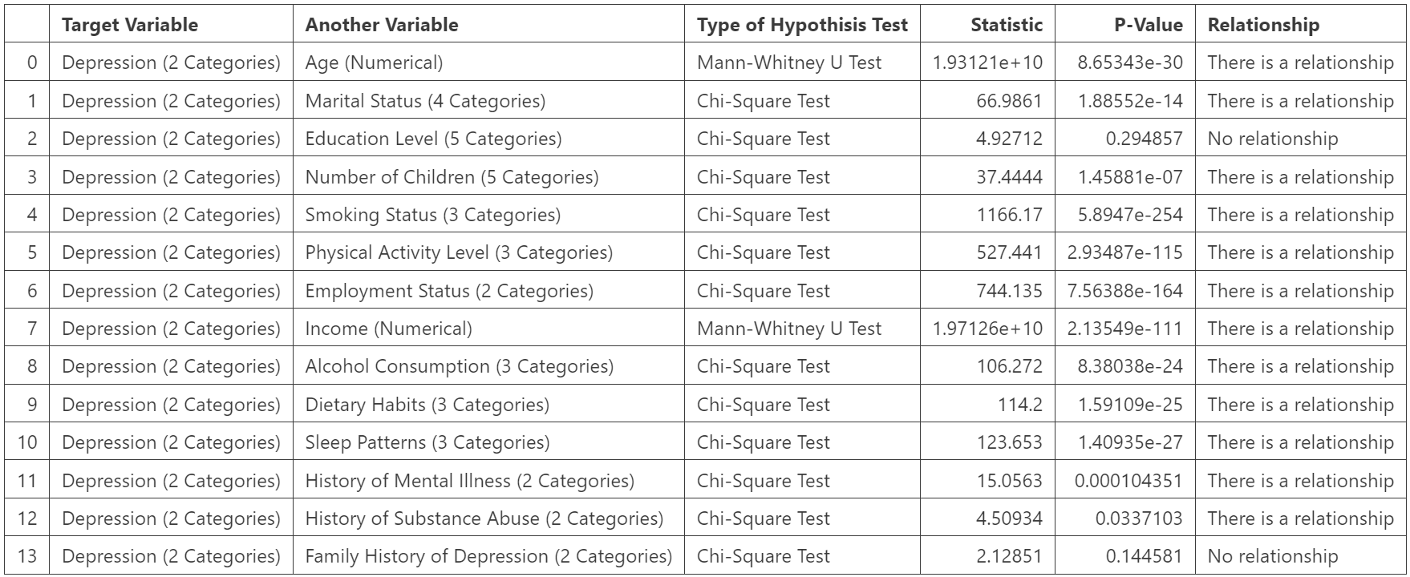
HYPOTHESIS TESTING
Team
One
H0 : There is no relationship among two variables
H1 : There is relationship among two variables

Slide 18

PIPELINE

Slide 19
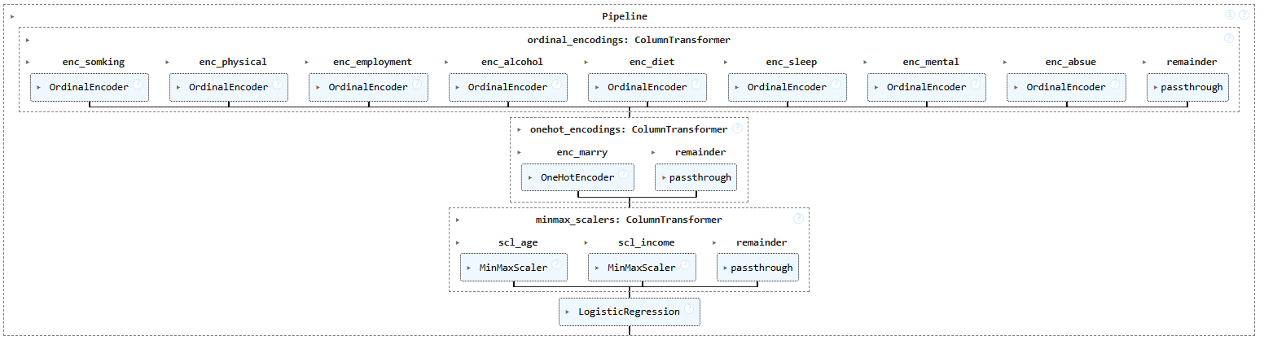
PIPELINE
Team
One

Slide 20
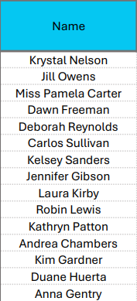
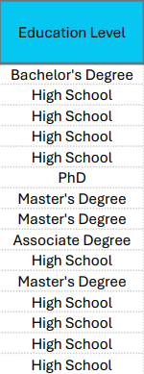
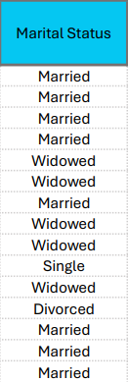
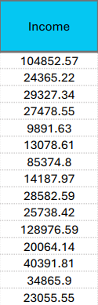
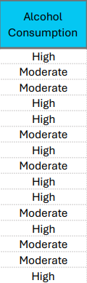
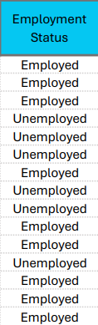
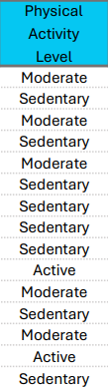
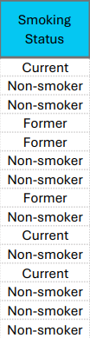
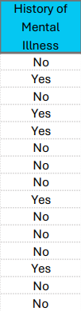
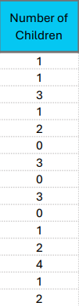
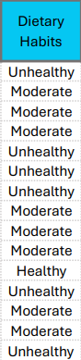
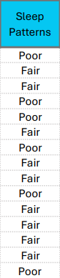
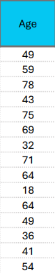
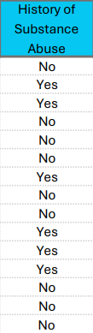
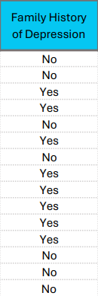
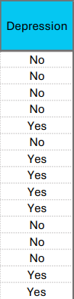
BIRD’S VIEW
Team
One

Slide 21
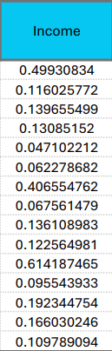
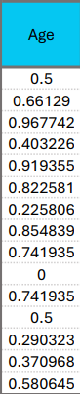
Team
One
Why..?
Equalizing Feature Influence
Improving Algorithm Performance
Preventing Domination by Large Values
We used “MinMax Scaler”, because of the outliers in “income” variable.
SCALING

Slide 22
SCALING
Team
One
Why..?
Equalizing Feature Influence
Improving Algorithm Performance
Preventing Domination by Large Values
We used “MinMax Scaler”, because of the outliers in “income” variable.
ONE HOT ENCODING

Slide 23
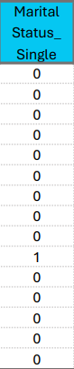
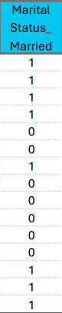
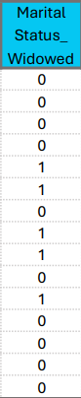
Team
One
Why..?
Algorithm Compatibility
Machine can understand only numbers
We used “One Hot Encoding” for “Marital Status” column
Marital_Status_Single | 1 | 0 | 0
Marital_Status_Married | 0 | 1 | 0
Marital_Status_Widowed | 0 | 0 | 1
Marital_Status_Divorced | 0 | 0 | 0
ONE HOT ENCODING

Slide 24
ONE HOT ENCODING
Team
One
Why..?
Algorithm Compatibility
Machine can understand only numbers
We used “One Hot Encoding” for “Marital Status” column
Marital_Status_Single | 1 | 0 | 0
Marital_Status_Married | 0 | 1 | 0
Marital_Status_Widowed | 0 | 0 | 1
Marital_Status_Divorced | 0 | 0 | 0

Slide 25
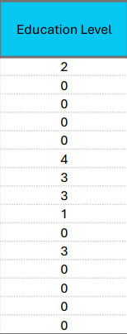
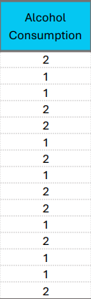
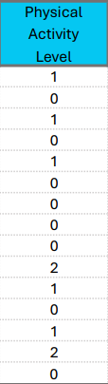
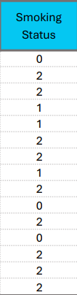
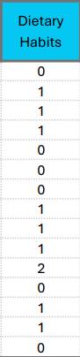
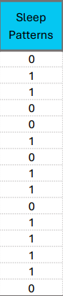
Marital_Status_Single | 1 | 0 | 0
Marital_Status_Married | 0 | 1 | 0
Marital_Status_Widowed | 0 | 0 | 1
Marital_Status_Divorced | 0 | 0 | 0
Team
One
ORDINAL ENCODING

Slide 26
Alcohol Consumption
Low | 0
Moderate | 1
High | 2
Physical Activity Level
Sedentary | 0
Moderate | 1
Active | 2
Education Level
High School | 0
Associate Degree | 1
Bachelor’s Degree | 2
Master’s Degree | 3
PhD | 4
Smoking Status
Current | 0
Non-Smoker | 1
Former | 2
Dietary Habits
Unhealthy | 0
Moderate | 1
Healthy | 2
Sleep Patterns
Poor | 0
Fair | 1
High | 2
ORDINAL ENCODING
Team
One
Why..?
Algorithm Compatibility
Machine can understand only numbers
We used “Ordinal Encoding” for “Education Level”, “Alcohol”, “Physical Activity”, “Smoking”, “Dietary”, and “Sleep” columns

Slide 27
ORDINAL ENCODING
Team
One
Alcohol Consumption
Low | 0
Moderate | 1
High | 2
Physical Activity Level
Sedentary | 0
Moderate | 1
Active | 2
Education Level
High School | 0
Associate Degree | 1
Bachelor’s Degree | 2
Master’s Degree | 3
PhD | 4
BINARY ENCODING
Smoking Status
Current | 0
Non-Smoker | 1
Former | 2
Dietary Habits
Unhealthy | 0
Moderate | 1
Healthy | 2
Sleep Patterns
Poor | 0
Fair | 1
High | 2

Slide 28
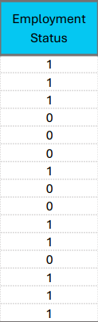
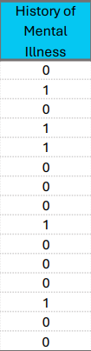
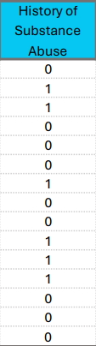
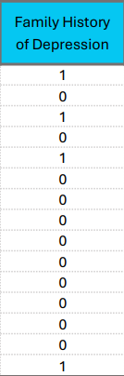
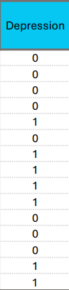
Team
One
BINARY ENCODING

Slide 29
Employment Status
Unemployed | 0
Employed | 1
History of Mental Illness
No | 0
Yes | 1
History of Substance Abuse
No | 0
Yes | 1
History of Depression
No | 0
Yes | 1
Depression
No | 0
Yes | 1
BINARY ENCODING
Team
One
Why..?
Algorithm Compatibility
Machine can understand only numbers
We used “Binary Encoding” for “Employment Status”, “Mental Illness”, “Abuse”, “Depression History”, “Depression”

Slide 30
BINARY ENCODING
Team
One
Employment Status
Unemployed | 0
Employed | 1
History of Mental Illness
No | 0
Yes | 1
History of Substance Abuse
No | 0
Yes | 1
History of Depression
No | 0
Yes | 1
Depression
No | 0
Yes | 1

Slide 31
ENCODED DATAFRAME
Team
One
Machine understandable Data frame is now ready. We can feed this into the algorithm.

Slide 32
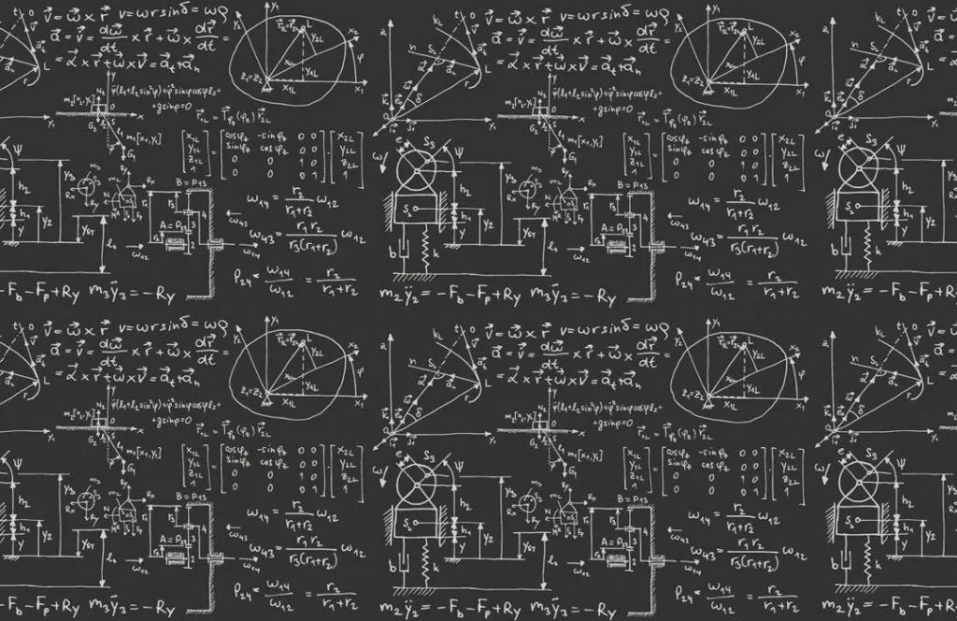
ML MODELS

Slide 33
PICKING PROPER METRIC
Team
One
TRUE
POSITIVE
FALSE
NEGATIVE
Depression - Yes
Confusion Matrix
This tell up about the counts of positives & negatives of the actual data and predicted data.
Actual Values
FALSE
POSITIVE
TRUE
NEGATIVE
Depression - No
Depression - Yes
Depression - No
Predicted Values

Slide 34
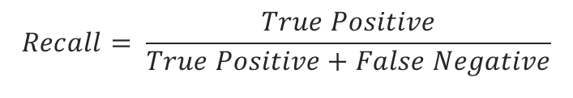
PICKING PROPER METRIC
Team
One
To find the best model we decided to choose a model which gives lowest “False Negative” value.
That is “Type-2 Error”
TRUE
POSITIVE
FALSE
NEGATIVE
Depression - Yes
Actual Values
FALSE
POSITIVE
TRUE
NEGATIVE
So, Recall would be a proper metric to decide the best model.
Depression - No
$$Recall= \frac{True Positive}{True Positive+False Negative}$$
Depression - Yes
Depression - No
Predicted Values

Slide 35
METRICS DISPLAY CODE
Team
One
show_metrics.py
show_metrics.py
y_pred = model.predict(x_test)
fig, axes = plt.subplots(nrows=1, ncols=3, figsize=(20, 8))
model_name = model if len(str(model)) <= 50 else str(model)[:50]+"...)"
fig.suptitle(f"\nClassification Metrics for {model_name}\n", fontsize=30)
#--------------------------------------------------------------------
cr = pd.DataFrame(classification_report(y_test, y_pred, output_dict=True)).T.iloc[:, :3]
accuracy = round((float(cr.loc["accuracy"][0]))*100, 2)
t = cr.iloc[[0,1], :]
t.index = ["Depression - No", "Depression - Yes"]
t = round(t, 2)
axes[0].axis('tight')
axes[0].axis('off')
t = axes[0].table(cellText=t.values, colLabels=t.columns, rowLabels=t.index, loc="center", cellLoc="center", rowLoc='right', fontsize=5, colColours=['#05C7F2']*3, rowColours=["#BCB7B1"]*4, colWidths=[0.25]*3)
t.scale(1, 3)
axes[0].set_title(f"Classification Report\n", fontsize=15)
axes[0].text(x=-0.018, y=0.035, s=f"Accuracy : {accuracy}%", fontsize=15)
#--------------------------------------------------------------------
l = np.array(["True Positive", "False Negative", "False Positive", "True Negative"])
cm = confusion_matrix(y_test, y_pred)
c = cm.flatten()
con_mat = pd.DataFrame(confusion_matrix(y_test, y_pred), index=["Depression - Yes", "Depression - No"], columns=["Depression - Yes", "Depression - No"])
sns.heatmap(con_mat, annot=np.array([f"{i}\n{j:,}" for i, j in zip(l, c)]).reshape(2,2), fmt="", cbar=False, ax=axes[1], cmap = ListedColormap(['#05C7F2']), linewidths = 1, annot_kws = {'size':15})
for i in range(cm.shape[0]):
for j in range(cm.shape[1]):
if i != j: # Check if not diagonal
# Set cell background to white
rect = plt.Rectangle((j, i), 1, 1, facecolor='#BCB7B1')
axes[1].add_patch(rect)
axes[1].set_xlabel("Predicted Values")
axes[1].set_ylabel("Actual Values")
axes[1].axis('tight')
axes[1].set_title(f"Confusion Matrix\n", fontsize=15)
#--------------------------------------------------------------------
fpr, tpr, _ = roc_curve(y_test, model.predict_proba(x_test)[:,1])
axes[2].plot(fpr, tpr, color='#05C7F2', label=f"ROC-AUC Score\n {roc_auc_score(y_test, model.predict_proba(x_test)[:,1]):.4f}", fillstyle="full")
axes[2].plot([0, 1], [0, 1],color='#A19C95', linestyle='dashed')
axes[2].fill_between(fpr, tpr, alpha=0.5, color='#BCB7B1')
axes[2].set_xlabel("False Postive Rate")
axes[2].set_ylabel("True Postive Rate")
axes[2].legend(loc="upper left")
axes[2].set_title(f"ROC-AUC Curve\n", fontsize=15)
plt.tight_layout()
plt.show()

Slide 36
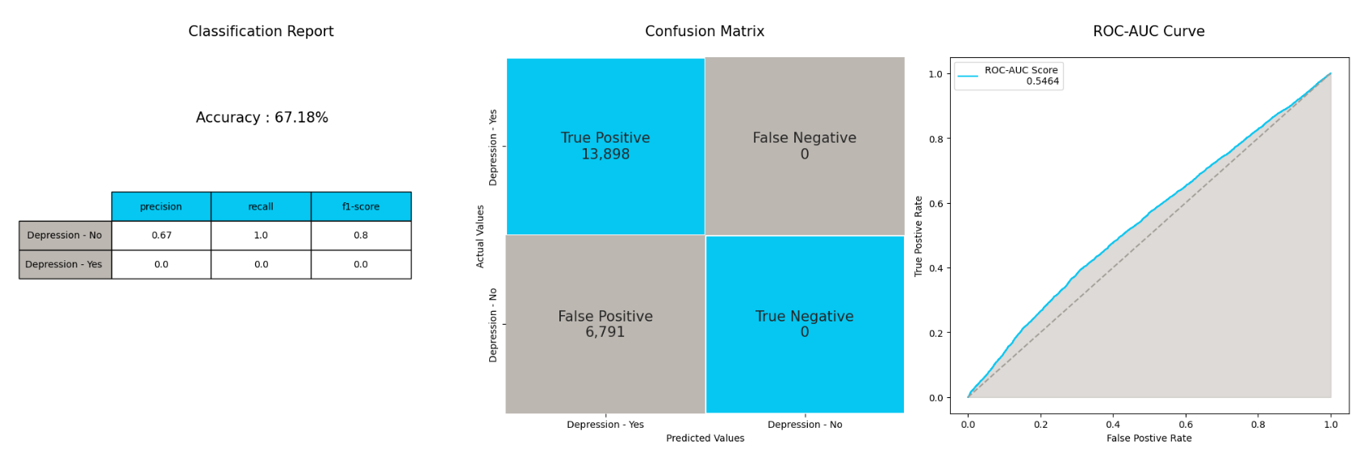
LOGISTIC REGRESSION
Team
One
Until
Now
Best Model is :
Logistic
Reg
Basic Logistic Regression is predicting every as “Yes”. The model could not able to differentiate between “Yes” and “No”

Slide 37
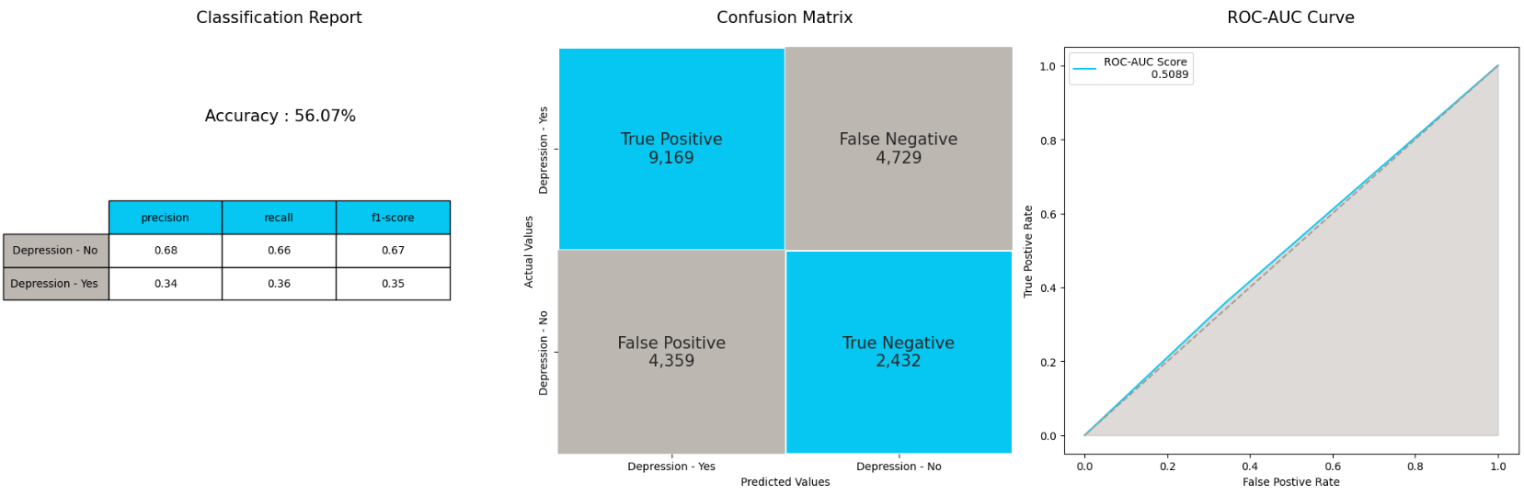
DECISION TREE CLASSIFIER
Team
One
Until
Now
Best Model is :
Decision Tree
Decision tree classifier is better that Logistic but, the recall for “Yes” is low

Slide 38
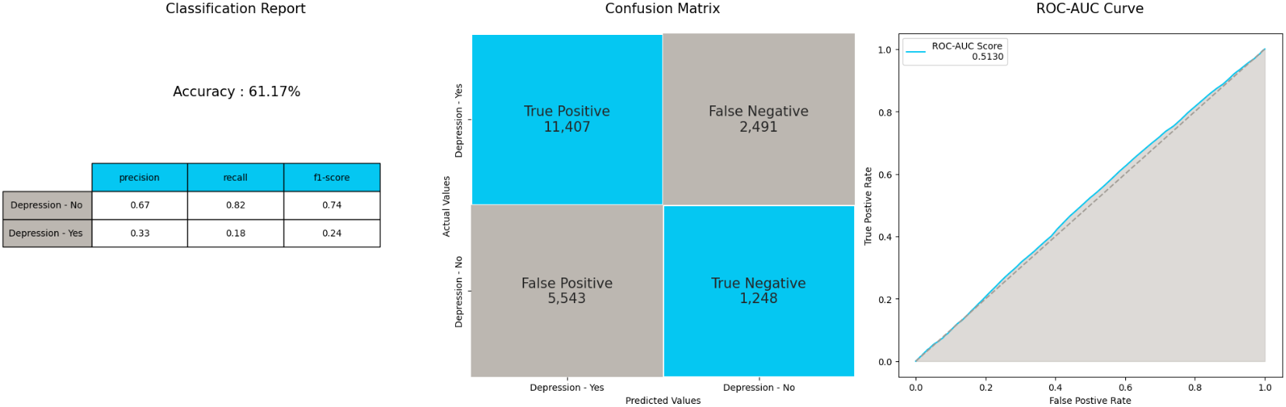
RANDOM FOREST CLASSIFIER
Team
One
Until
Now
Best Model is :
Decision Tree
Random forest classifier’s recall for “Yes” is low. And by ROC-AUC Curve we can tell that the model is not able to differentiate between the classes.

Slide 39
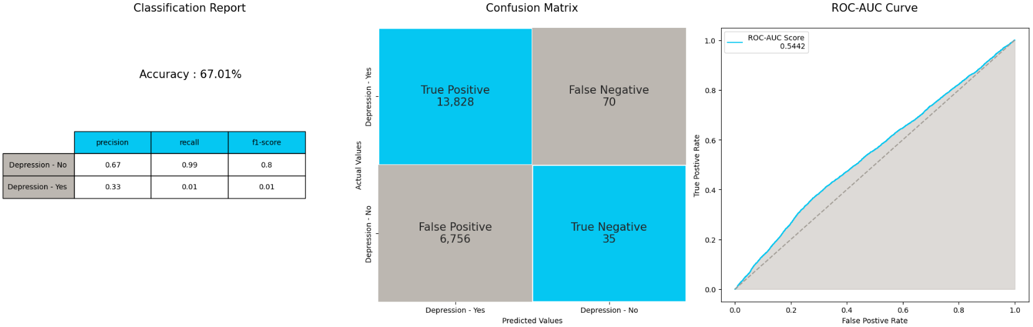
XG BOOST CLASSIFIER
Team
One
Until
Now
Best Model is :
Decision Tree
XG Boost classifier is same like Logistic regression. Can not able to classify between “Yes” and “No”

Slide 40
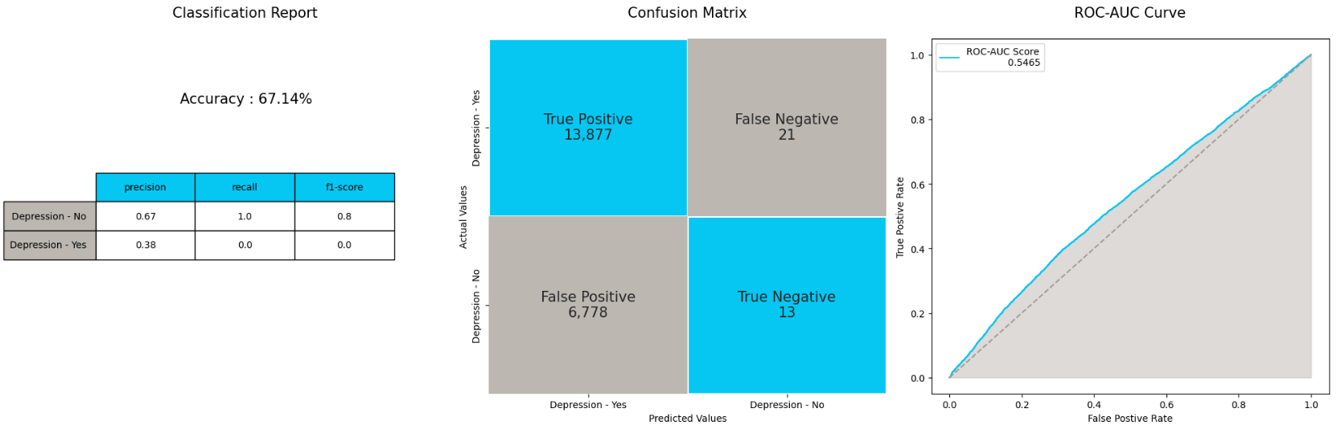
LOGISTIC REGRESSION
Team
One
Until
Now
Best Model is :
Decision Tree
This logistic regression is done by using weights for each class.
weights - { “No” : 1, “Yes” : 1.3 }
It is same as regular logistic regression

Slide 41
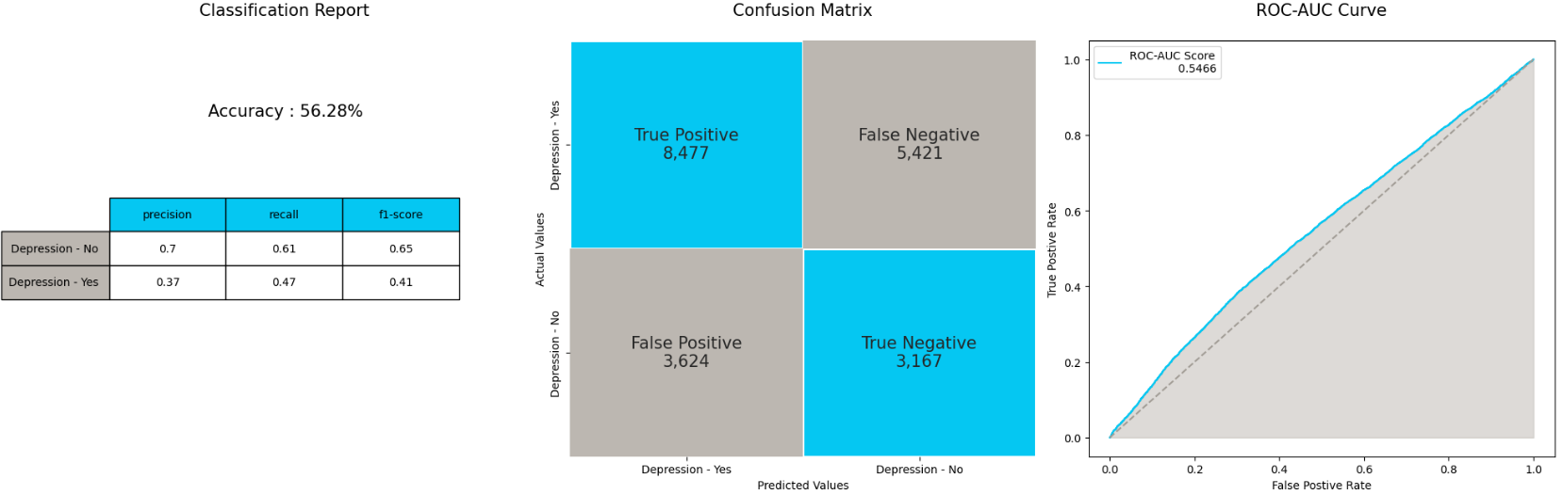
LOGISTIC REGRESSION
Team
One
Until
Now
Best Model is :
Logistic
Reg with weights
This logistic regression is done by using weights for each class.
weights - { “No” : 1, “Yes” : 1.2 }
This is better that all models. The recall scores are higher than all

Slide 42
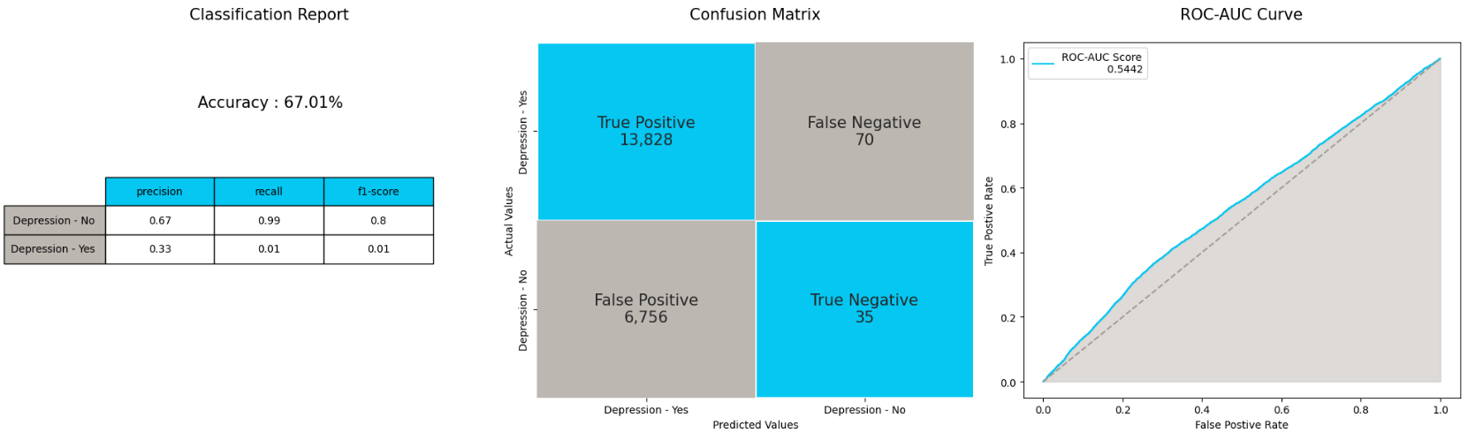
VOTING CLASSIFIER
Team
One
Until
Now
Best Model is :
Logistic
Reg with weights
This model is not able to differentiate among classes same as Basic Logistic Regression

Slide 43

XGB WITH SMOTE
Team
One
Until
Now
Best Model is :
Logistic
Reg with weights
This model is not able to differentiate among classes but better than Basic Logistic Regression

Slide 44
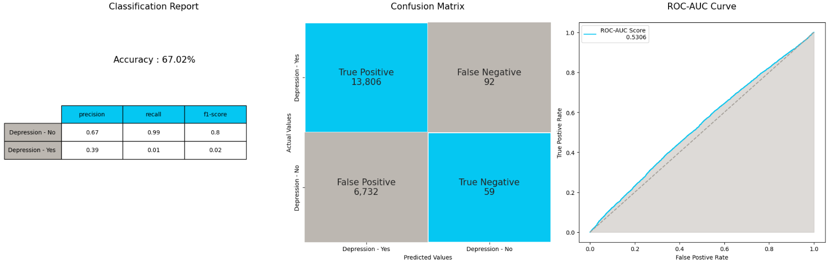

ADVANCE MODELS
Team
One
SGD
Classifier
Until
Now
Best Model is :
Logistic
Reg with weights
Light
GBM

Slide 46



Base Model
Team
One
<.py code>
We have use “Logistic Regression” is a base model. It gave 67% accuracy, but the model failed to detect class 1 datapoints in test data.
Possible Reasons for failing of algorithm:
Class Imbalance
Insufficient Features
Model Limitations
Classification Report

Slide 47
Works to be done:
Team
One
Will check if this data is satisfying the assumption of Linear Regression?
Linearity
Independence of Residuals
Homoscedasticity
Normality of Residuals
No Multicollinearity
Will do statistical tests to know which feature is important to predict target
Will do PCA to make sure there is no Multicollinearity.
Will do transformation on Numerical features
Will do hyperparameter tunning
Will check is this data performs better in clustering rather that classification
Will try various other classification algorithms
Will to feature engineering
Will make this whole algorithm dynamic using OOPs – (Pipeline)

Slide 48


THANK YOU
Session is open for Questions
PGPDSE – Hyd, Mar’24
TeamONE
Dileep, Praneeth, Sreekar, Ghouse
Mentored by - Ankush Bansal

